Slide 1
mathematical optimization
CO2- Gradient descent

Slide 2





AIM OF THE SESSION
To familiarize students with the concept of Constrained optimization.
INSTRUCTIONAL OBJECTIVES
This Session is designed to:
Introduction to the Gradient Descent Method
Working with the Gradient Descent Method
Examples of the Gradient Descent Method
LEARNING OUTCOMES
At the end of this session, the students should be able to:
Understand Gradient Descent method

Slide 3
Gradient descent, Newton's method: AN INTRODUCTION
Gradient descent, Newton's method, and the conjugate gradient method are all iterative algorithms used to find the minimum of a function, often in the context of optimization problems.
Gradient descent is a first-order method, while Newton's method is a second-order method.
The conjugate gradient method is an iterative method that can be seen as an improvement over gradient descent, offering faster convergence than steepest descent while avoiding the computational cost of Newton's method.

Slide 4
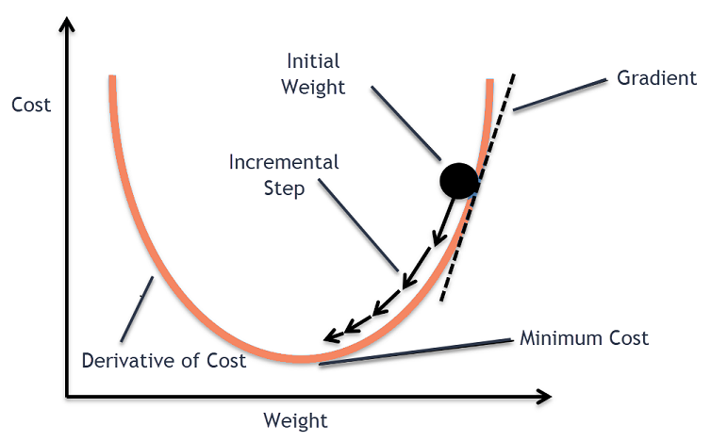
Gradient descent
Gradient descent is an optimization algorithm used in machine learning to minimize the cost function by iteratively adjusting parameters in the direction of the negative gradient, aiming to find the optimal set of parameters.
The cost function represents the discrepancy between the predicted output of the model and the actual output. The goal of gradient descent is to find the set of parameters that minimizes this discrepancy and improves the model’s performance.

Slide 5
Gradient descent
Algorithm:
Take the derivative of loss function for each parameter in it. In fancy ML take gradient of the loss function.
Pick random values for the parameters.
Plug the parameter values into derivatives(gradient).
Calculate the step sizes:
Step size = slope * learning rate.
5. Calculate new parameter:
New parameter = old parameter – step size.
Now go back to step3 & repeat until step size is very small or you reach the max no of steps.
→

Slide 6
Gradient descent
Example1:
Let's say we want to minimize the function f(x) = x² - 4x + 5 using gradient descent.
1. Initialization: Start with an initial guess, x₀ = 0.
Iteration:
  Gradient: The gradient of f(x) is f'(x) = 2x - 4.
  Update: x₁ = x₀ - learning_rate * f'(x₀). Let's use a learning rate of 0.1.
    x₁ = 0 - 0.1 * (2 * 0 - 4) = 0.4
    x₂ = 0.4 - 0.1 * (2 * 0.4 - 4) = 0.68
    x₃ = 0.68 - 0.1 * (2 * 0.68 - 4) = 0.944
... and so on.
You would continue this process until the change in x between iterations becomes very small, indicating that the algorithm has converged.

Slide 7
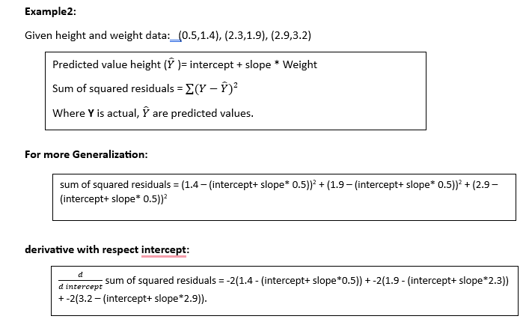
Gradient descent

Slide 8
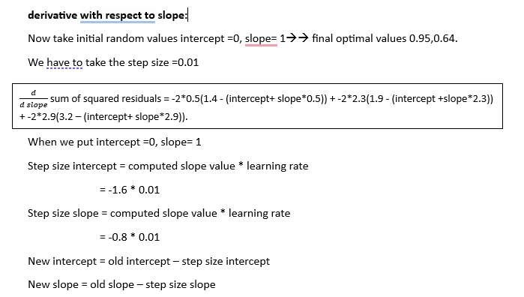
Gradient descent

Slide 9
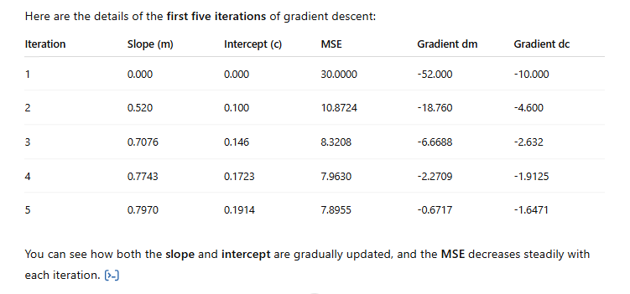
Gradient descent

Slide 10
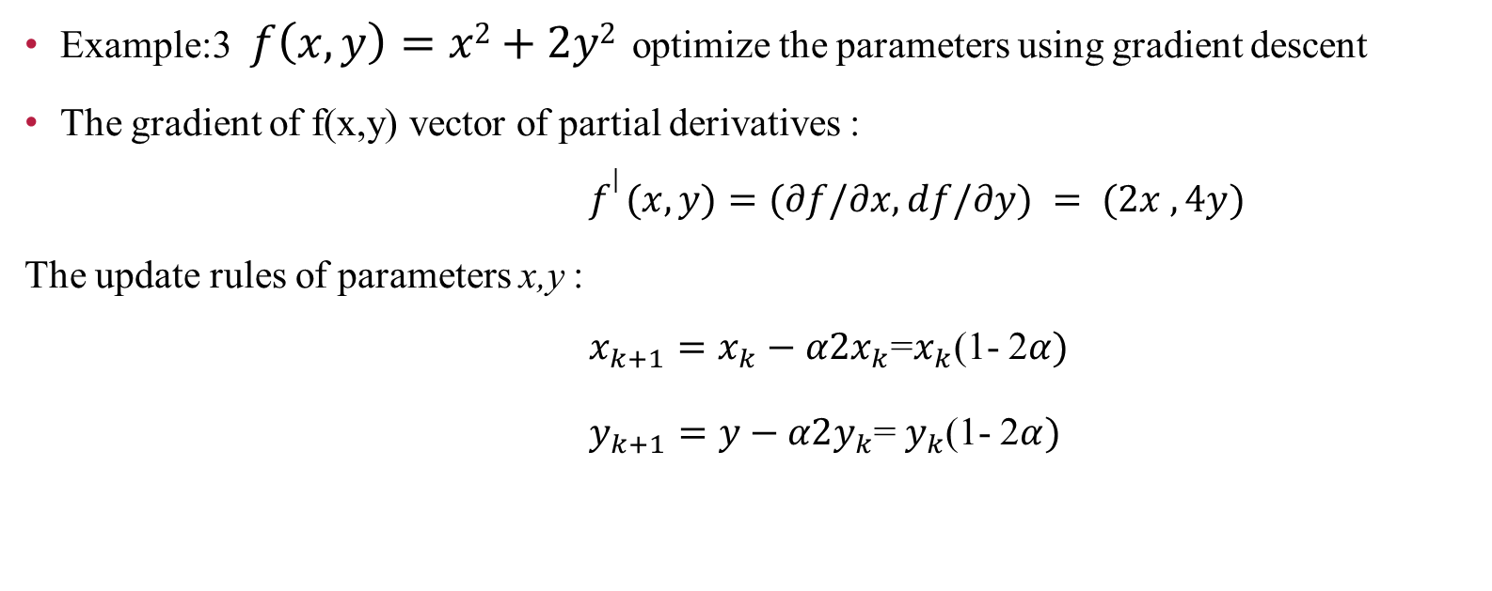
Gradient descent
Example:3 $f\left(x,y\right)=x2+2y2$ optimize the parameters using gradient descent
The gradient of f(x,y) vector of partial derivatives :
$f| (x,y)=(∂f/∂x,ⅆf/∂y) = (2x ,4y)$
The update rules of parameters x,y :
$x_{k+1}=x_{k}−α2x_{k}$=$x_{k}$(1- 2$α)$
$y_{k+1}=y−α2y_{k}$=$y_{k}$(1- 2$α)$

Slide 11
Gradient descent
^{Let’s take:}
^{• x=1, y=1}
^{• α=0.1}
^{• Run 5 iterations:}
^{Iteration x y f(x, y)}
^{0 1.000 1.000 1 + 2 = 3}
1 0.800 0.600 0.64 + 0.72 = 1.36
2 0.640 0.360 0.41 + 0.26 ≈ 0.67
3 0.512 0.216 0.26 + 0.09 ≈ 0.35
4 0.410 0.130 0.17 + 0.034 ≈ 0.21
5 0.328 0.078 0.11 + 0.012 ≈ 0.13

Slide 12
Gradient descent
1. What is gradient descent? Give the update rule for gradient descent?
2. How does gradient descent work?
3. What are the advantages of gradient descent?
Give some applications of gradient descent.
How does the learning rate affect the convergence of gradient descent? Demonstrate with an example.f(x)=(x−3)² α=0.1
Given the following set of ordered pairs (3,8), (9,6), (5,4), (3,2), and assume that the relationship between x,y is approximately linear(y=mx+c). Your task is to optimize the parameters m (slope) and c (intercept) by minimizing the Mean Squared Error (MSE) cost function using the gradient descent algorithm.

Slide 13
Thank You

